Slide 1


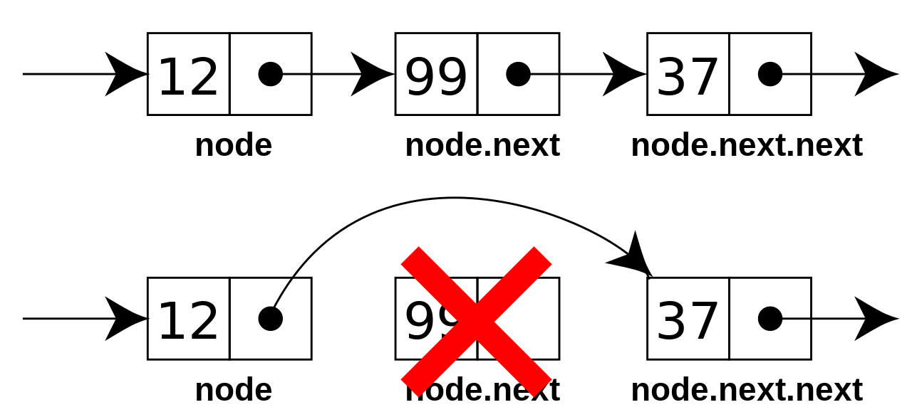
Linear Containers
Multidimensional Arrays, Lists, Queues, Stacks
Zhivko Petrov
A guy that knows C++
Notes:
© Software University Foundation – http://softuni.org
This work is licensed under the Creative Commons Attribution-NonCommercial-ShareAlike license.
<number>

Slide 2

Table of Contents
Multidimensional Arrays
Data Structures - Concept
STL Linear Containers
std::vector
Iterators
std::list
std::stack & std::queue
<number>
Notes:
© Software University Foundation – http://softuni.org
This work is licensed under the Creative Commons Attribution-NonCommercial-ShareAlike license.
<number>

Slide 3
Questions
sli.do #cpp-softuni

Slide 4

WHAT IF I TOLD YOU
A MATRIX IS JUST NUMBERS
IN ROWS AND COLUMNS
Multidimensional Arrays
Matrices and Higher Dimensions

Slide 5
Multidimensional Arrays
C++ can make arrays act "as if" they have many dimensions
"as if" – they are just normal arrays which are indexed differently
Compiler enforces dimension syntax in code
Imagine each element is actually an array
2D (matrix): array of arrays (each element is a "normal" array)
3D array: array of 2D arrays (each element is a matrix)
Most-common usage: making a matrix/table
<number>

Slide 6
Using Multidimensional Arrays
Accessing elements is done with one indexer per dimension
matrix 1st element (column) of 2nd row is matrix[1][0]
Declaring: add a [size] for each additional dimension
First dimension can omit size
E.g. int matrix2Rows3Cols[2][3] or just matrix2Rows3Cols[][3] (needs initializer, unless function parameter)
<number>

Slide 7
Using Multidimensional Arrays
Each dimension is an array with 1 less dimension
int matrix2Rows3Cols[][3] = { {11, 12, 13}, {21, 22, 23} };
int cube[2][3][4] = { { {111, 112, 113, 114}, {121, 122, 123, 124}, {131, 132, 133, 134} }, { {211, 212, 213, 214}, {221, 222, 223, 224}, {231, 232, 233, 234} } }
If no initializer {} brackets, values are undefined
If more elements than initialized, others are defaults
<number>

Slide 8
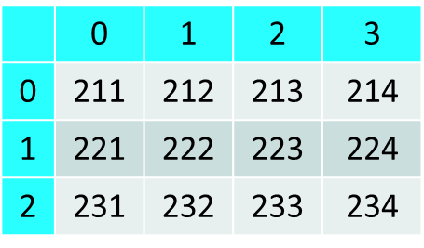
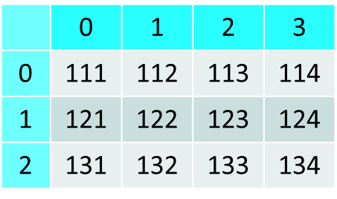
0 |  |  |  |  | 1
 | 0 | 1 | 2 | 3 |  | 0 | 1 | 2 | 3
0 | 111 | 112 | 113 | 114 | 0 | 211 | 212 | 213 | 214
1 | 121 | 122 | 123 | 124 | 1 | 221 | 222 | 223 | 224
2 | 131 | 132 | 133 | 134 | 2 | 231 | 232 | 233 | 234
Multidimensional Arrays
LIVE DEMO

Slide 9
Quick Quiz
TIME:
What will the following code do?
cause a compile-time error
cause a runtime error due to index being out of bounds
set matrix[2][0] to 0
summon demons
you know nothing
const int rows = 4;
const int cols = 3;
int matrix[rows][cols] = {
{11, 12, 13},
{21, 22, 23},
{31, 32, 33},
{41, 42, 43}
};
matrix[1][3] = 0;
<number>

Slide 10
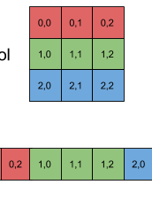
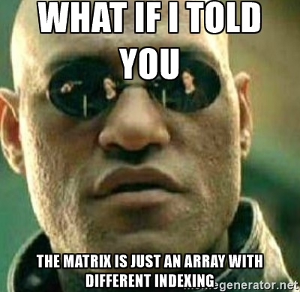
C++ Pitfall: “Out of Bounds Inside” Multidimensional Arrays
C++ (C actually) stores multidimensional arrays as 1D, by joining up together 1st dimension elements, e.g. for 2D arrays – joining up rows into a 1D array.
This is called “row-major order”
E.g. for a matrix[rows][cols] accessing [r][c] just means [r * cols + c] in the actual array
<number>

Slide 11
Row-Major Order in Multidimensional Arrays
LIVE DEMO

Slide 12
"Multidimensional" Containers
We know std::vector can contain any type
… actually any type with a default constructor
int, double, char, string, even another std::vector, etc.
Often containers (e.g. vectors) will contain other containers
E.g. a vector of vectors (2D), a vector of vector of vectors (3D)
Element access is the same code as with multidimensional arrays
Note: no row-major order (not contiguous in memory)
<number>

Slide 13
"Multidimensional" Containers
LIVE DEMO

Slide 14
Data Structures
Classifying Data Containers by Operation

Slide 15
Data Structures
Data Structures organize data for efficient access
Different data structures are efficient for different use-cases
Essentially – a data container + algorithms for access
Some of the common data structures in computer science:
Arrays – fast access by index, constant/dynamic size
Linked-list – fast add/remove at any position, no index access
Map/Dictionary – contains key/value pairs, fast access by key
<number>

Slide 16
Complexity 101
Complexity in Computer Science describes performance
How fast an algorithm runs & How much memory it consumes
Based on the size of the input data – usually denoted as N
We usually care about the worst-case performance
How do we measure complexity?
time = number of basic steps, memory = number of elements
Complexity is usually denoted by the Big-O notation
How much the number of steps grows compared to input size
<number>

Slide 17
Complexity 101
We usually care about X orders of magnitude, not +X or *X
O(N+3) == O(2N) == O(N), i.e. we care about the N parts
If something takes 1 million or 2 million years, it's the "million" that bothers you, not the "1" or the "2"
O(1) – "constant" time/memory – input size has no effect
O(log(N)) – logarithmic – complexity grows as log(input) grows
O(N) – linear – complexity grows as input grows
O(N²), O(N³), … – quadratic, cubic, … – complexity grows with square/cube/etc. of input size
O(2^{N}), O(3^{N}), … – exponential – this is a monster
<number>

Slide 18
Data Structure Performance 101
If N is the number of elements in the container (the .size()):
 | vector | list | map, set | unordered_map, unordered_set
access i^{th} | O(1) | O(i) | O(i) | ---
find(V) | O(N) | O(N) | O(log(N)) | O(1) (usually)
insert(V) | O(1) at end (usually), O(N) otherwise | O(1) | O(log(N)) | O(1) (usually)
erase(V) | O(1) at end (usually), O(N) otherwise | O(1) | O(log(N)) | O(1) (usually)
Getting a sorted sequence | O(N*log(N)) (using std::sort algorithm) | O(N + N*log(N)) (using .sort() method) | O(N) (by just iterating) | ---
<number>

Slide 19
STL Linear Containers
Vectors, Lists, Iterators, Container Adapters

Slide 20
std::vector
Represents an array, has all array operations (i.e. operator[])
Changes size automatically when elements added
push_back() complexity is amortized O(1)
i.e. usually takes O(1) time, occasionally takes O(N) time
i.e. slow ~10 times out of ~1000, ~32 times out of ~4 billion, etc.
Fast access O(1) to any element (random index access)
arr[0] = 69; arr[15] = 42;
<number>

Slide 21
std::vector
LIVE DEMO

Slide 22
size_t and size_type
Alias of one of the integer types
E.g. unsigned long int or unsigned long long int
Able to represent the size of any object in bytes
E.g. sizeof() returns size_t
Each STL container offers a similar ::size_type
A good practice is to use it instead of int for sizes, positions, etc.
for (vector<int>::size_type i = 0; i < nums.size(); i++) {
cout << nums[i] << endl;
}
<number>
Notes:
© Software University Foundation – http://softuni.org
This work is licensed under the Creative Commons Attribution-NonCommercial-ShareAlike license.
<number>

Slide 23
Container Iterators
STL Iterators are things that know how to traverse a container
operator++ - moves iterator to the next element
operator* - accesses the element
operator-> - same as operator. on the element
Each container has an iterator (e.g. std::vector<T>::iterator)
Each container has begin() and end() iterators
begin() points to first element, end() to AFTER last
Range-based for loop uses those to work on ANY container
<number>

Slide 24
Using Iterators with Vectors
Using iterators on vectors is almost the same as using indexes
To walk over a vector:
Start from begin(), move with ++ until you reach end()
Access the current element with *
vector<int> nums {42, 13, 69};
for (vector<int>::iterator i = nums.begin(); i != nums.end(); i++) {
cout << *i << endl;
}
// Equivalent code
for (vector<int>::size_type i = 0; i < nums.size(); i++) {
cout << nums[i] << endl;
}
<number>

Slide 25
Using Iterators
Example: Change each element in the vector by dividing it by 2
Example: Print each string element and its length
vector<int> numbers {42, 13, 69};
for (vector<int>::iterator i = numbers.begin(); i != numbers.end(); i++) {
*i /= 2;
}
// Equivalent code
for (int i = 0; i < numbers.size(); i++) {
numbers[i] /= 2;
}
vector<string> words {"the", "quick", "purple", "fox"};
for (vector<string>::iterator i = words.begin(); i != words.end(); i++) {
cout << *i << ": " << i->size() << endl;
}
// Equivalent code
for (int i = 0; i < words.size(); i++) {
cout << words[i] << ": " << words[i].size() << endl;
}
<number>

Slide 26
Using Iterators with Vectors
LIVE DEMO

Slide 27
Why Use Iterators?
Vectors may not need iterators, because they have indexes
i.e. they have sequential elements accessible by operator[]
Not all containers have indexes
Only std::array, std::vector & std::deque have indexes
The other containers don't offer access by index
Iterators work on all containers, abstract-away container details
Doesn't matter what container you iterate, code is the same
<number>

Slide 28
std::list
Represents elements connected to each other in a sequence
std::list<int> values; std::list<string> names;
Each element connects to the previous and next element. Like Christmas lights
All element access is done with iterators
Can add or remove elements anywhere in O(1) time
Requires iterator to where an element should be added/removed
push_back(), push_front(), insert(), size(), …
<number>

Slide 29
std::list
LIVE DEMO

Slide 30
Container Adaptors
Wrap a container (e.g. vector) with a different interface
Allow you to express intentions better
Make code more abstract and focused on the task, not the code
STL Adapters for common Computer Science data structures:
std::stack is a first-in, last-out (LIFO) data structure
std::queue is a first-in, first-out (FIFO) data structure
std::priority_queue is a data structure that gives quick access to the "highest priority item"
<number>

Slide 31
Stack Example: “Browser History”
Write a program which takes 2 types of browser instructions:
Normal navigation: a URL is set, given by a string
The string /back that sets the current URL to the last set URL
After each instruction the program should print the current URL
If the /back instruction can’t be executed, print "no previous URLs"
<number>

Slide 32
std::stack
Represents a container (a deque by default) working like a stack
A stack is a "first-in, last-out structure" (FILO)
Imagine a pile of bricks – the last brick you put is the first you can remove
Access to elements other than top() is not provided
top() gets the top, pop() removes it, push(T) adds to top
<number>

Slide 33
Queue Example: “Browser History”
Extend “Browser History” with a /forward instruction
Visits URLs that were navigated away from by /back
Each /forward instruction visits the next most-recent such URL
If a normal navigation happens, all potential /forward URLs are removed until a new /back instruction is given
If the /forward instruction can’t be executed, print "no next URLs"
<number>

Slide 34
std::queue
Represents a container (deque by default) working like a queue
A queue is a "first-in, first-out" structure (FIFO)
Imagine a line at a store – first person in the line is the first to get out
Access to elements other than front() is not provided
front() gets first, pop() removes it, push(T) adds to back
<number>

Slide 35
std::priority_queue
Represents a queue, but elements are ordered by priority
By default, "larger" elements have higher priority
Imagine a queue at a hospital's emergency room – Patients with more serious cases treated BEFORE those with less serious ones
Higher priority elements move in front of lower priority ones
Getting top-priority element is O(1), insertion is log(N)
To get top-priority element use top() (instead of front())
<number>

Slide 36
Container Adaptors
LIVE DEMO

Slide 37

Summary
C++ Multidimensional arrays are just normal arrays
… with indexing for each dimension
We usually measure performance based on input
We care how quickly much performance degrades based on input size. We use Big-O notation to denote that
C++ offers several linear data structures and adaptors
vector, list, stack, queue, priority_queue
Each is efficient for certain use-cases
<number>

Slide 38
https://softuni.bg/trainings/courses
Notes:
© Software University Foundation – http://softuni.org
This work is licensed under the Creative Commons Attribution-NonCommercial-ShareAlike license.
<number>

Slide 39












SoftUni Diamond Partners

Slide 40




SoftUni Organizational Partners

Slide 41




Trainings @ Software University (SoftUni)
Software University – High-Quality Education and Employment Opportunities
softuni.bg
Software University Foundation
http://softuni.foundation/
Software University @ Facebook
facebook.com/SoftwareUniversity
Software University Forums
forum.softuni.bg
Notes:
© Software University Foundation – http://softuni.org
This work is licensed under the Creative Commons Attribution-NonCommercial-ShareAlike license.
<number>

Slide 42
License
This course (slides, examples, demos, videos, homework, etc.) is licensed under the "Creative Commons Attribution-NonCommercial-ShareAlike 4.0 International" license
Notes:
© Software University Foundation – http://softuni.org
This work is licensed under the Creative Commons Attribution-NonCommercial-ShareAlike license.
<number>

